Slide 1
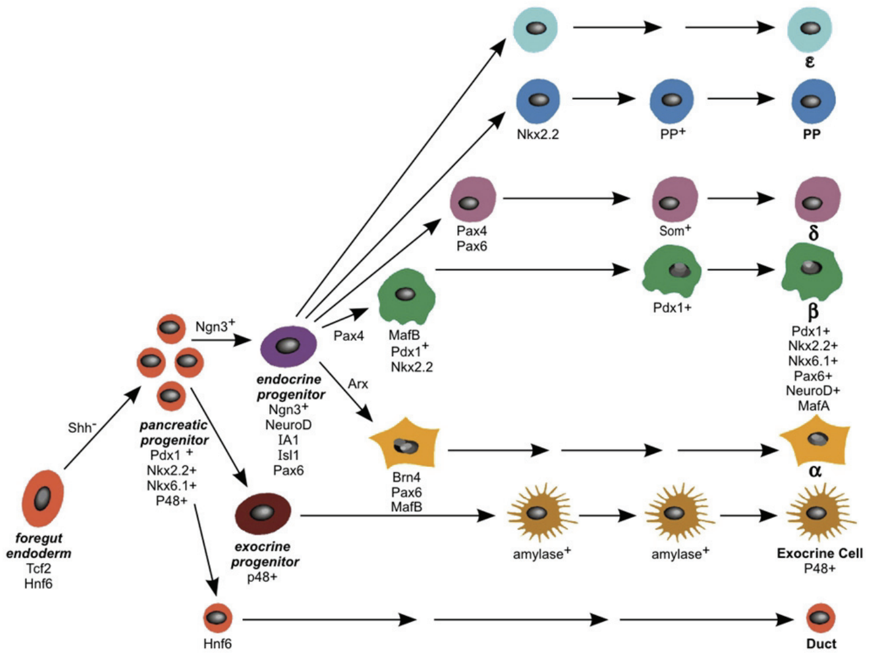
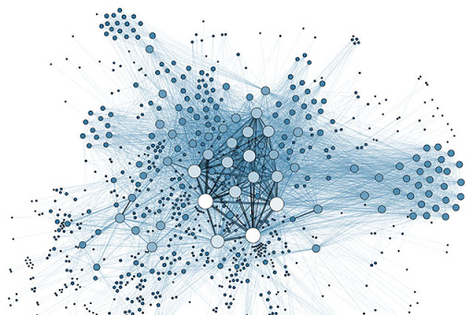
The Goal
Networks --------------------> Experiments
Predict intervention strategies to manipulate cellular identity or differentiation trajectories based on models of transcription factor networks.

Slide 2
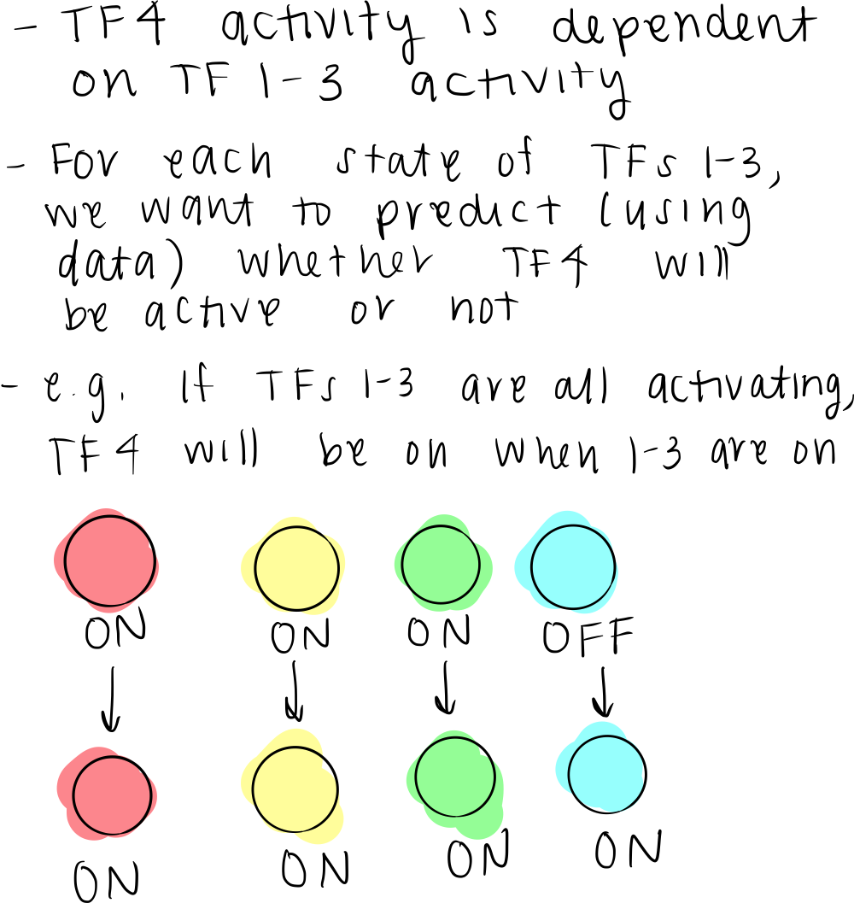
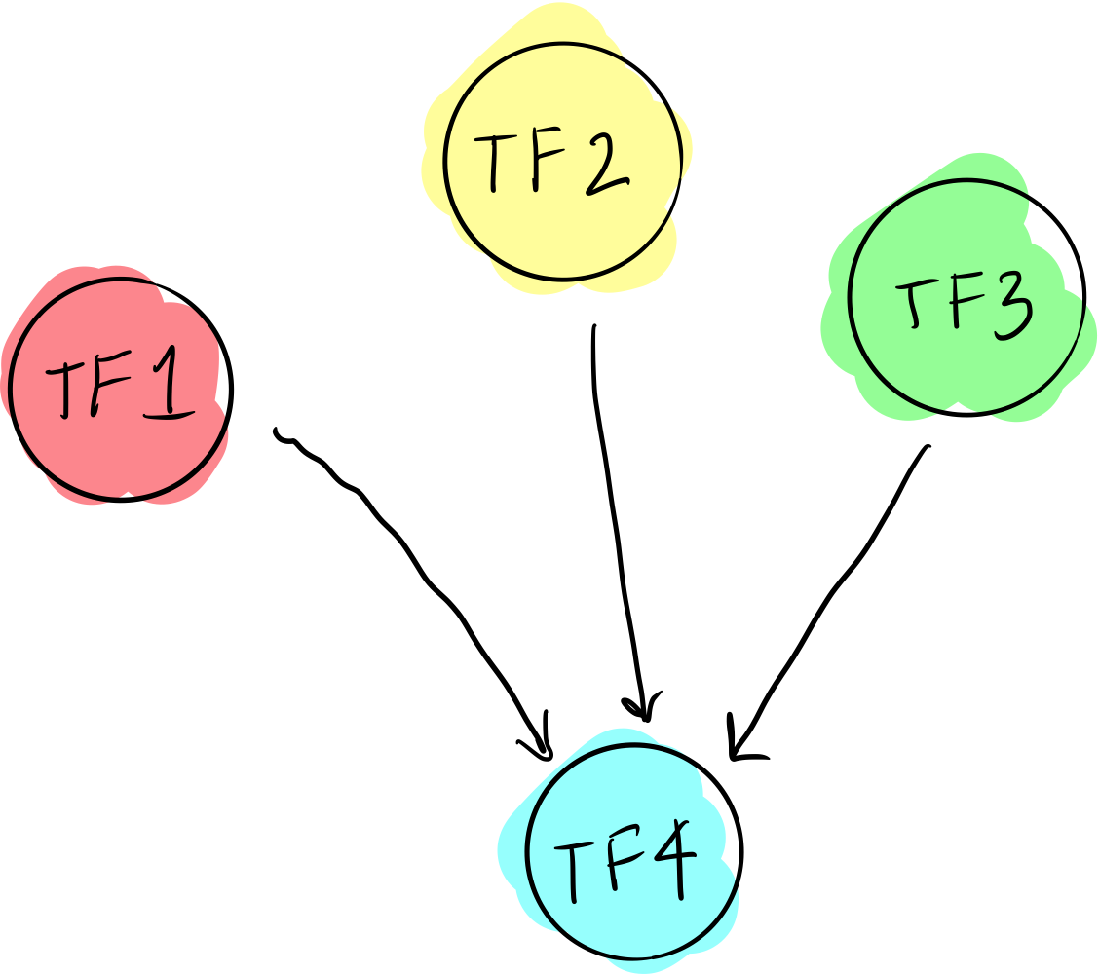
BooleaBayes Overview
How do we go from a network to predicting dynamics of cell identity?
We need rules that tell us where to go based on our current state
These rules are based on the structure of our network

Slide 3
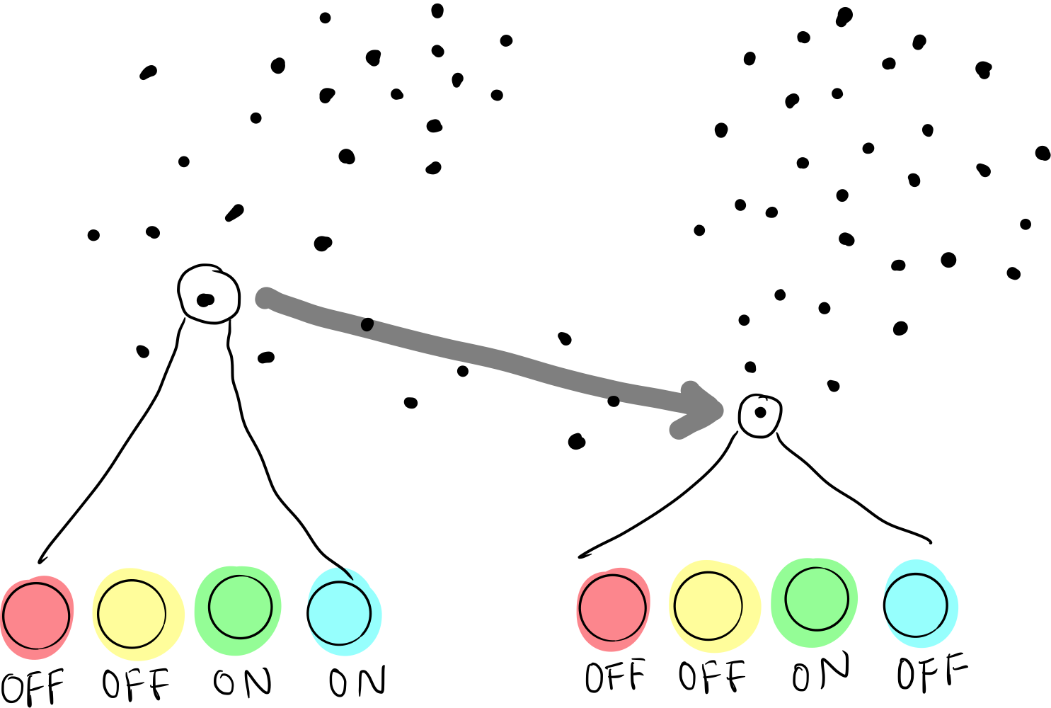
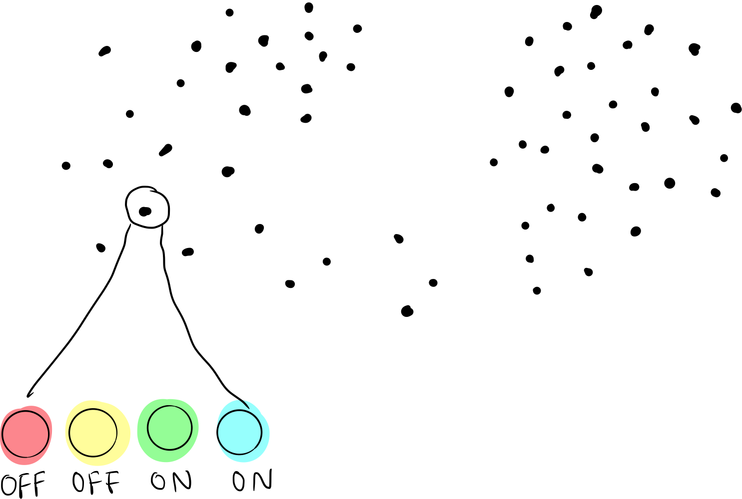
BooleaBayes Overview
How do we go from a network to predicting dynamics of cell identity?
We need rules that tell us where to go based on our current state
These rules are based on the structure of our network

Slide 4
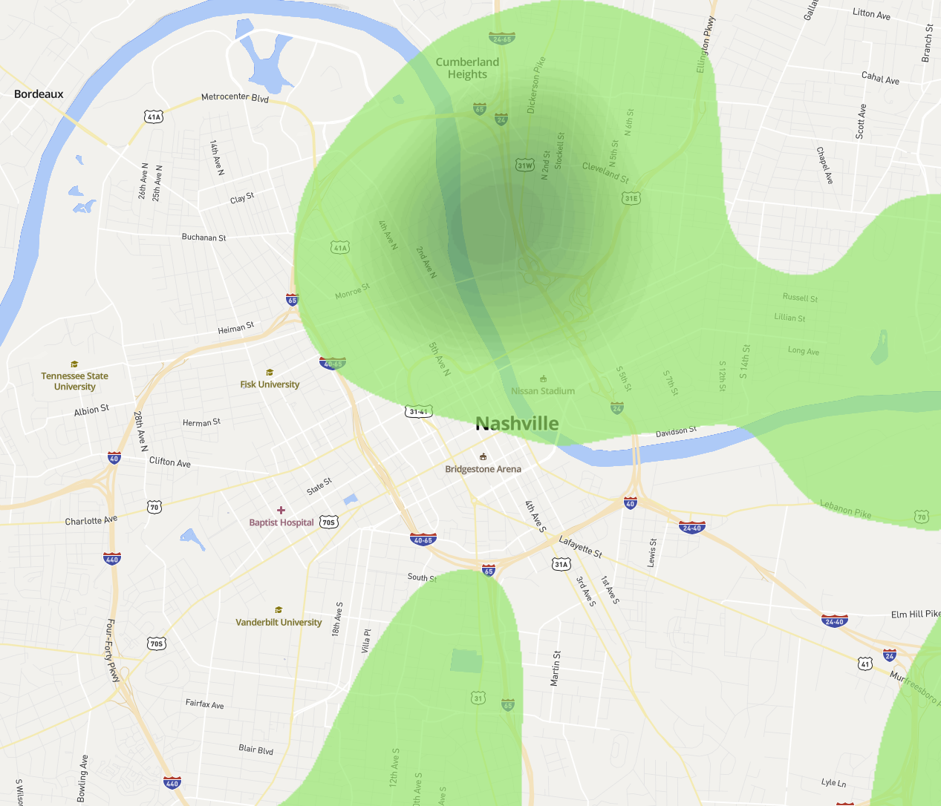
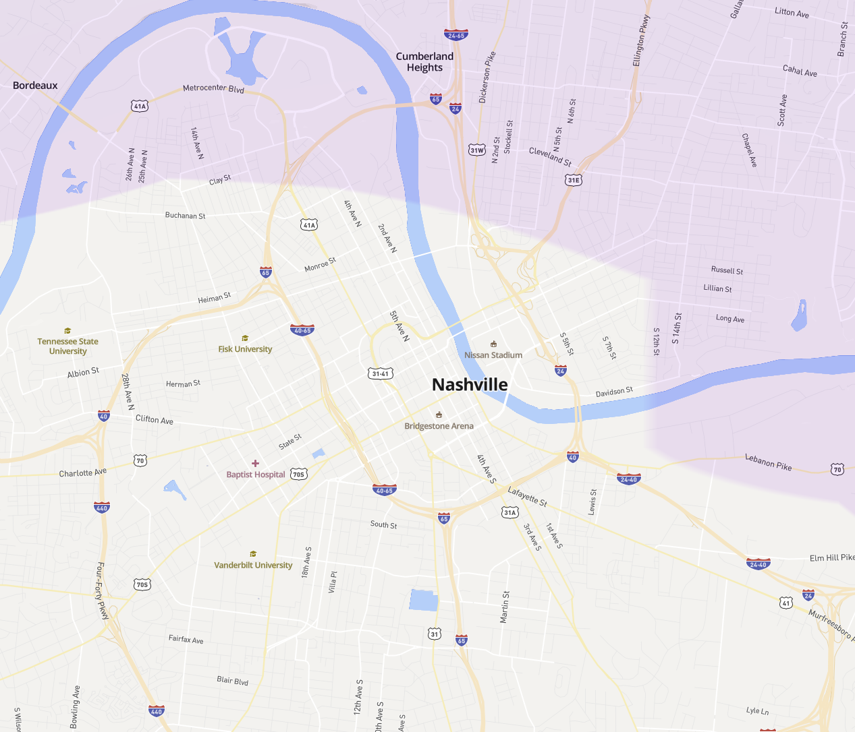
Ideal Data
Sample count is not the same thing as informative

Slide 5
Ideal Data
Need the transitions to accurately “forecast”

Slide 6
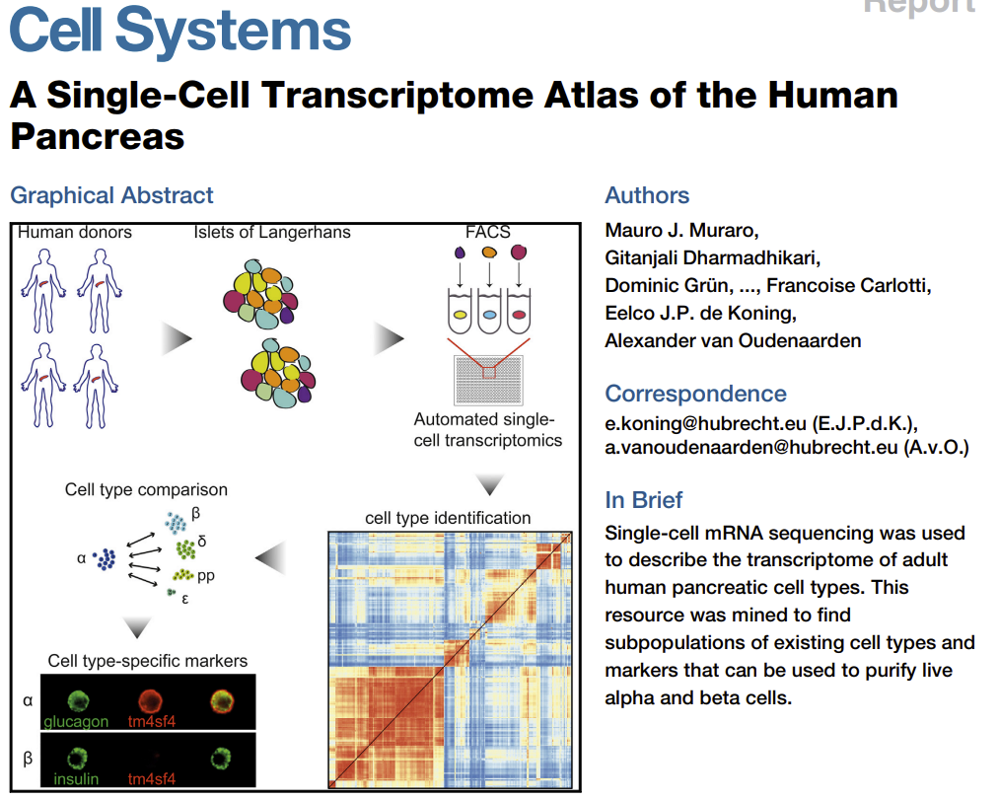
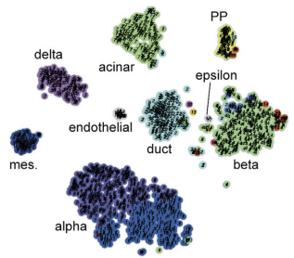
(not) Ideal Data

Slide 7
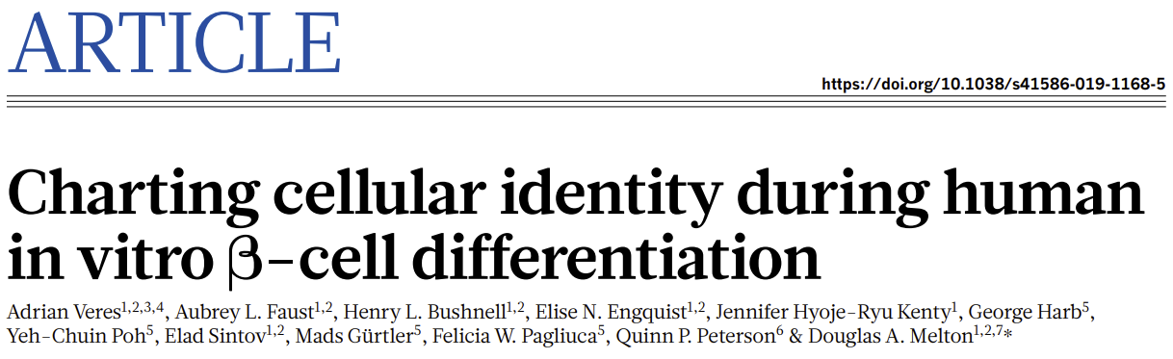
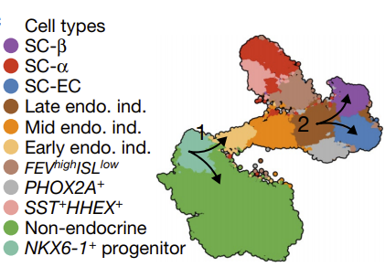
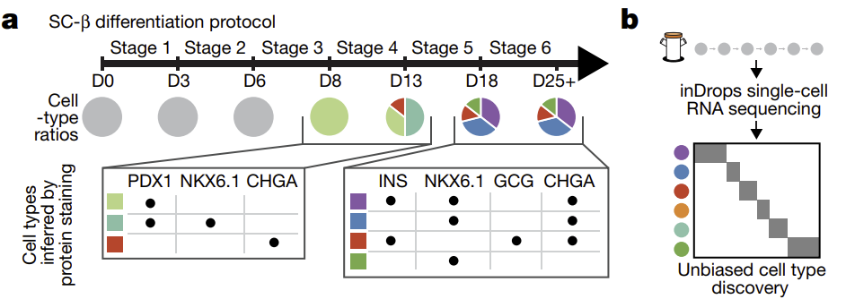
Preliminary Case Study: Melton Nature paper with scRNAseq for in vitro differentiation

Slide 8
In silico experiment design
Different Network Types:
-Literature derived
-Build network from differentially expressed genes using multiple databases (e.g. ENCODE)
-Build network from genes which vary in pseudotime using the same databases
Different Thresholds:
-How do we binarize the data
-How do we filter out interactions which are not important
Different Data Imputation
-MAGIC vs. SC-IMPUTE
Initially split the data 80/20 for training and testing. So 20% of the cells will never be used to fit the boolean rules
Of the 80% remaining data run 5X cross validation to estimate robustness of fitting results.

Slide 9
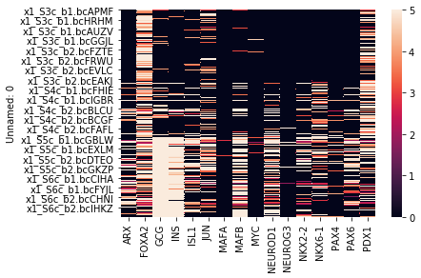
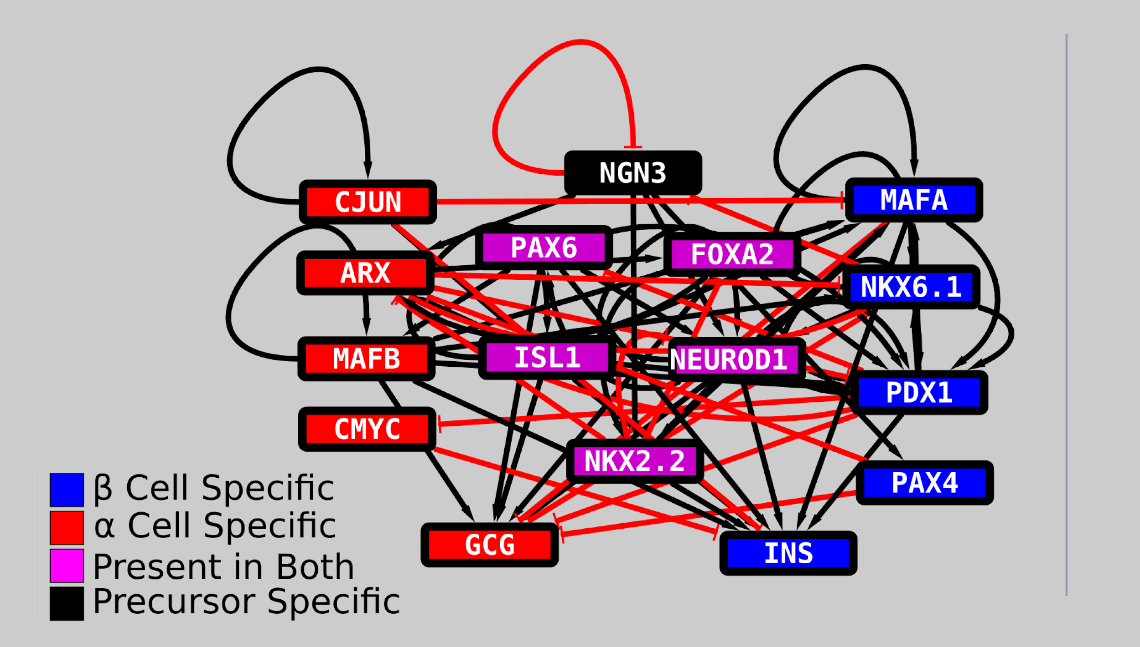
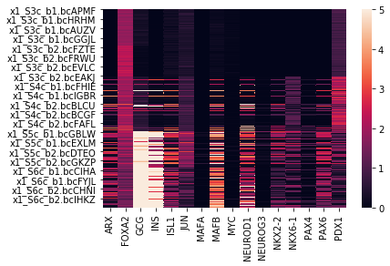
For example...
Before MAGIC Imputation
Literature Derived Network Model + MAGIC imputation
After MAGIC Imputation

Slide 10
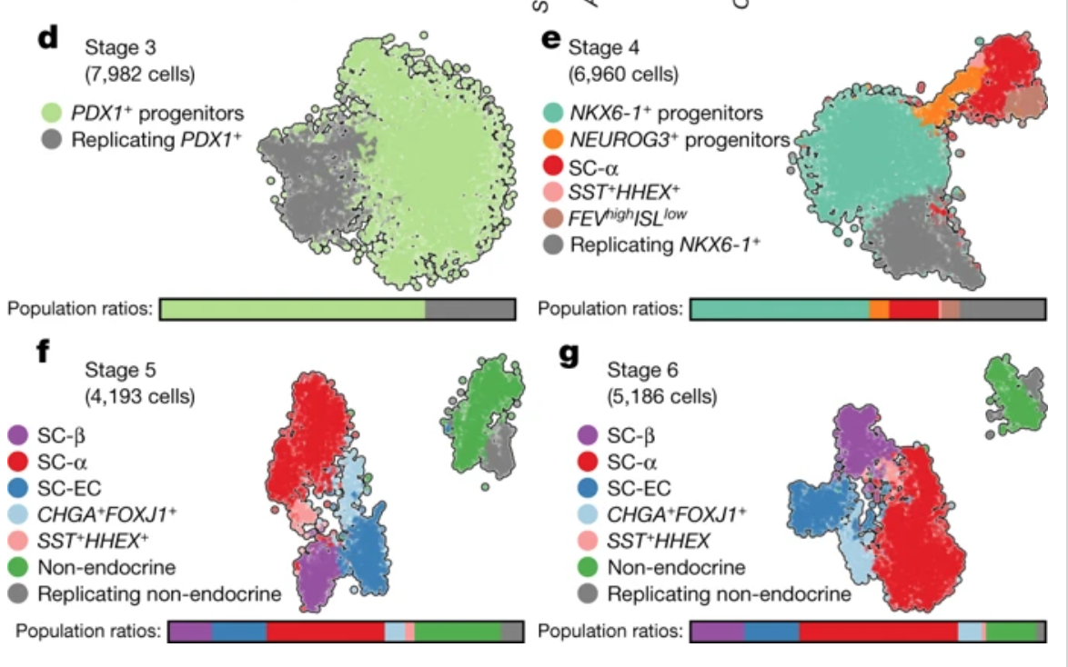
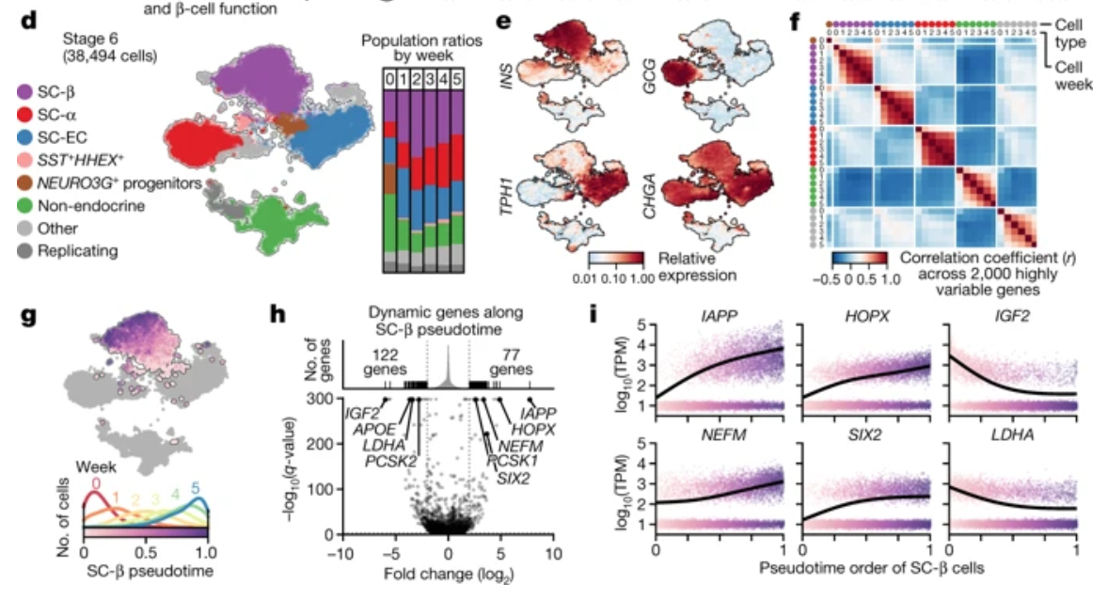
For example...
Differential Expression Analysis
Computed differentially expressed genes between each cell type from stages 3-6 (shown on right)
Kept all top genes or filtered to more stringent requirements, such as fold-increase in cell type of interest
Pseudo-time analysis
In Veres et al., the authors looked at “pseudo-time” across the data-- in other words, the likely trajectory across individual cell types based on the structure of the data
Using the pseudo-time analysis from the paper, we chose the top 100 genes the correlate with pseudotime
These genes were used as input to build the network structure

Slide 11
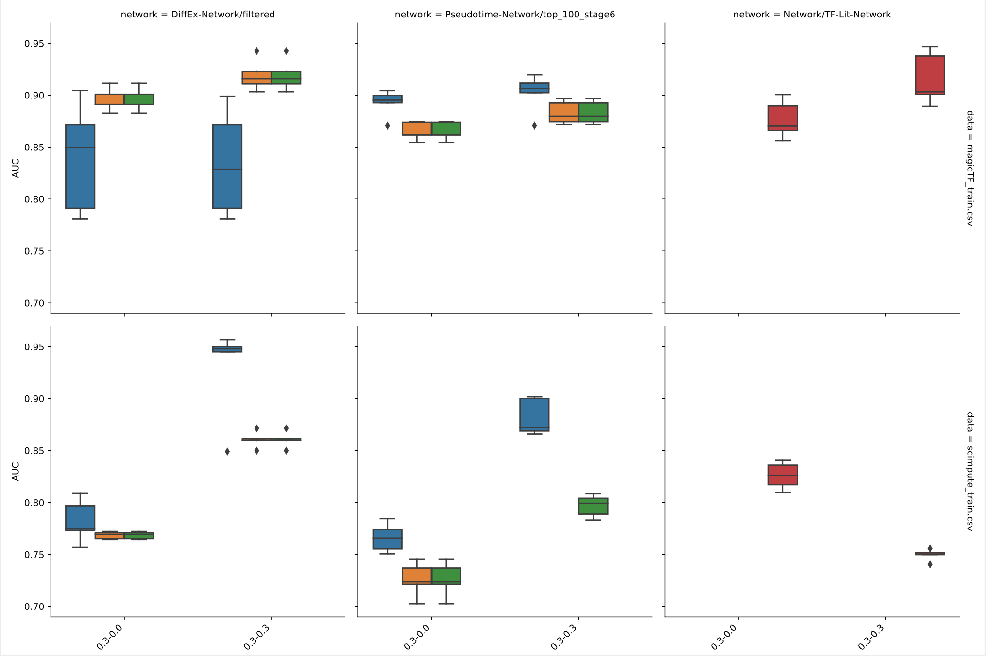
Preliminary Results
Differential Exp.
Pseudo-time
Literature Network
Conclusions:
AUC variance between folds is low.
MAGIC easier to predict than SC-IMPUTE
Lit-network is pretty good
Variance between genes is larger (not shown)
No filtering was applied to literature derived network (red)
Variance shown between repeated analyses (cross-fold validation)
MAGIC
Improving Average Fit
Increased Filtering
SC-impute

Slide 12
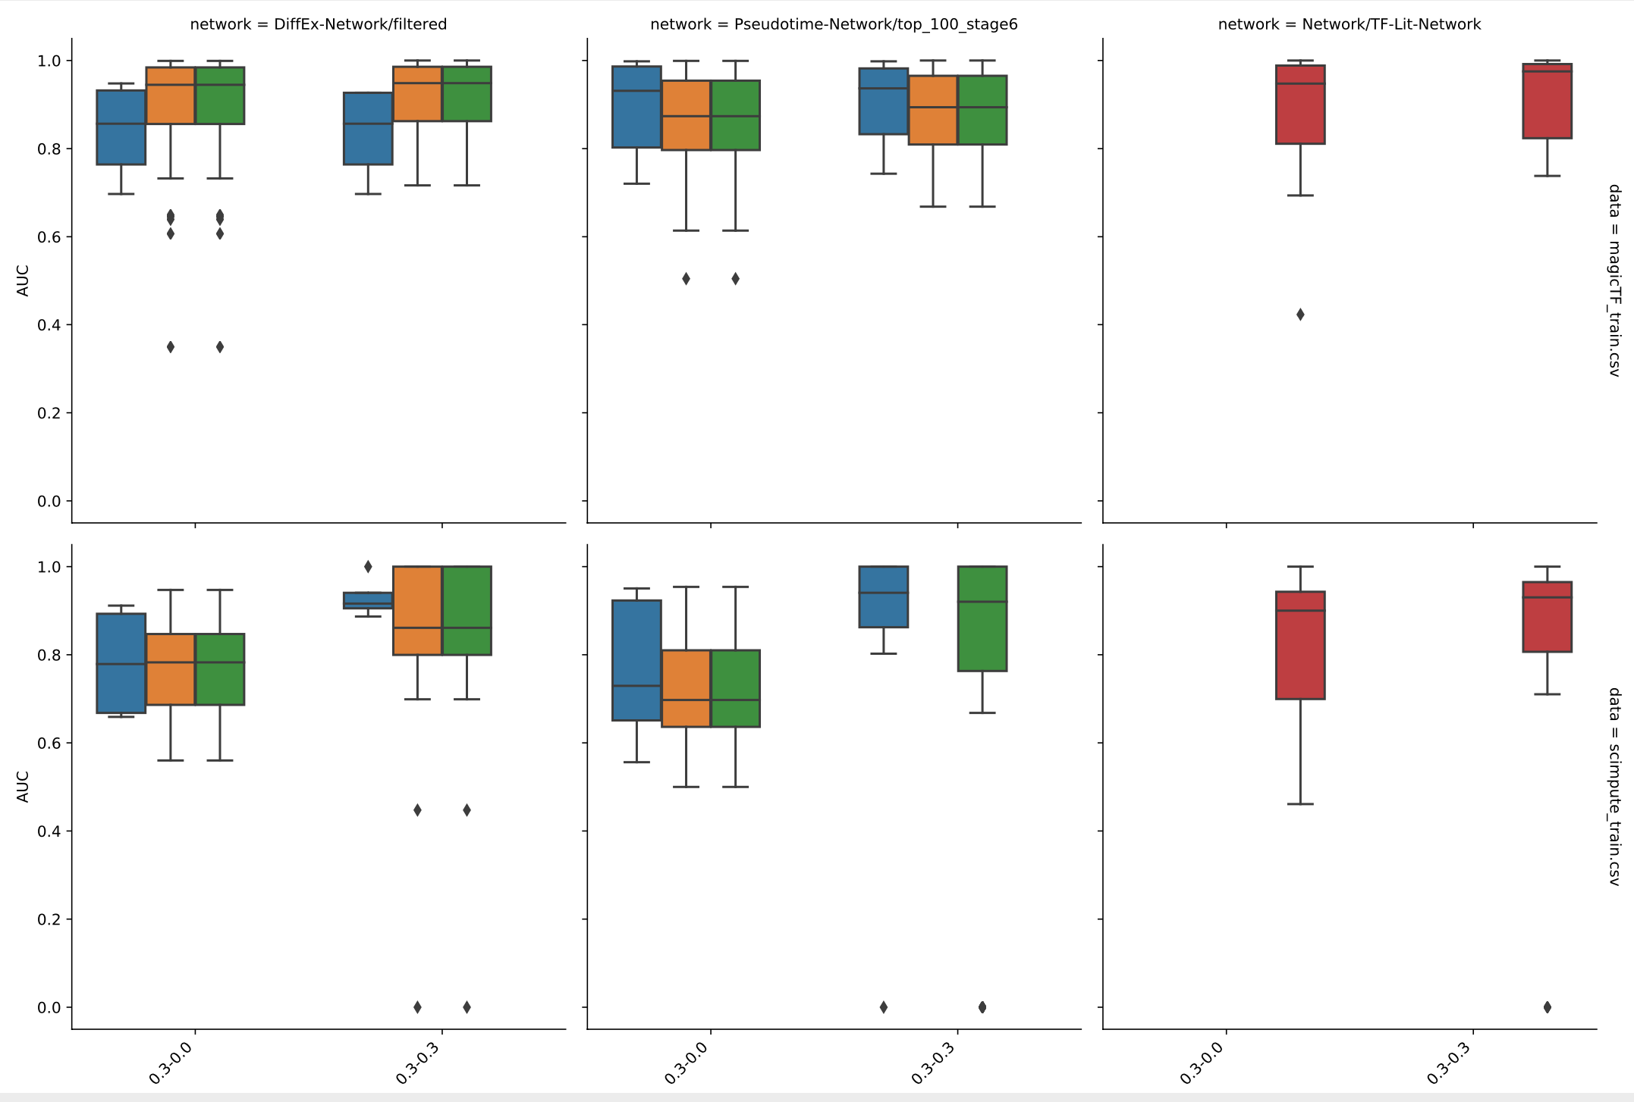
Preliminary Results
Filtering steps progress from green → orange → blue
No filtering was applied to literature derived network (red)
Variance shown between genes

Slide 13
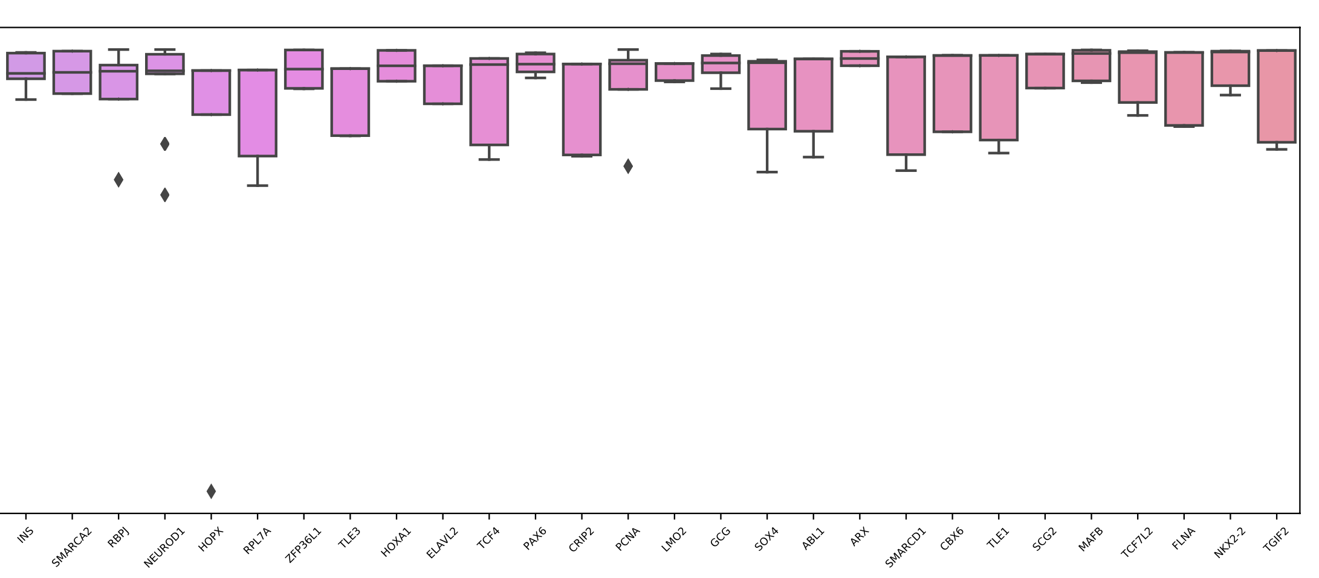
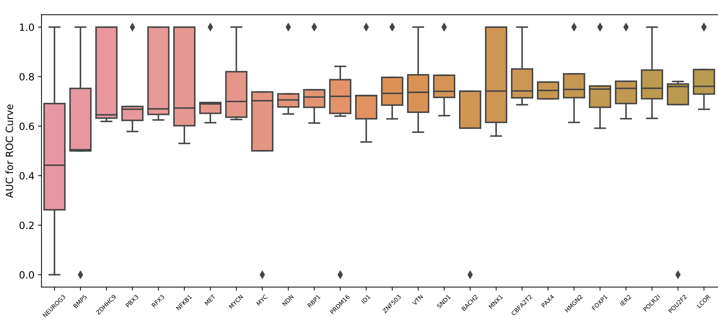
Preliminary Results
Goodness of fit for individual transcription factors vary widely-- some genes are fit more accurately than others

Slide 14
Preliminary Results
Cross-fold validation shows that our results are reproducible
Goodness of fit for individual transcription factors vary widely-- some genes are fit more accurately than others
MAGIC imputation seems to be better than scImpute
The literature derived TF network is about as good as the network derived from differential expression analysis

Slide 15
Immediate next steps
Compare to random permutations of networks
Select 3 best models and using ensembles find core motifs most important for predictions
Overlay model simulations on data and find attractors
Find regulators of bifurcation junctures.

Slide 16
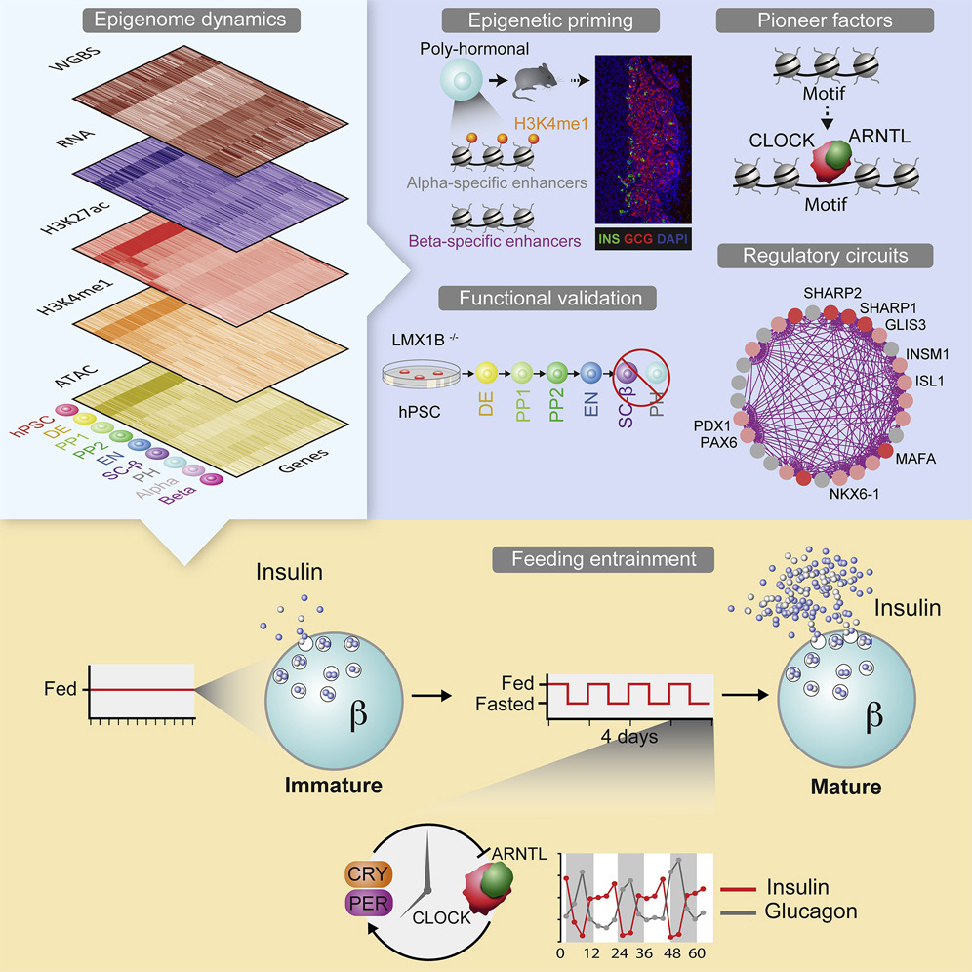
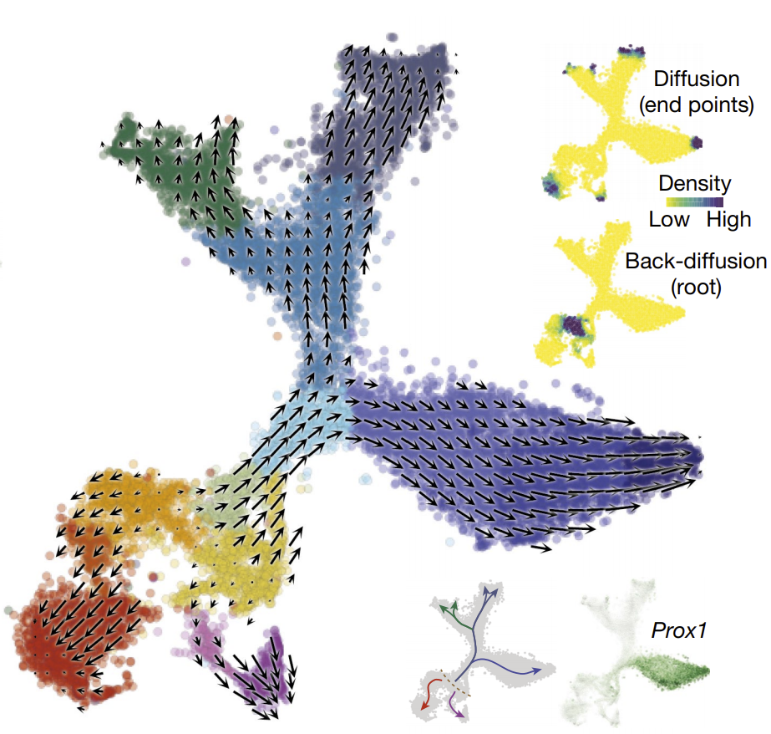
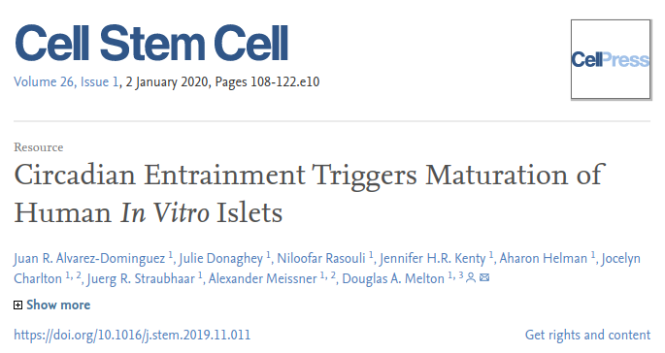
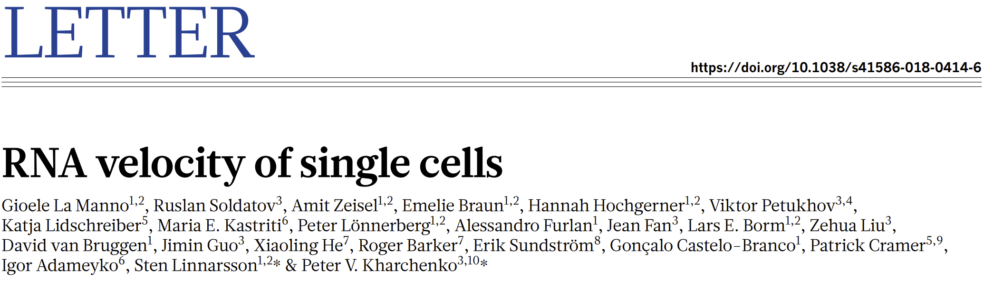
Long term goals
Incorporate RNA velocity
Incorporate ATACseq information
Test manipulation strategies
Identify Pioneer Factors from Simulations

Slide 19
Magic > scimpute
For scimpute more filtering is better for diffex-network
Diffex network/filtered and lit-network the node threshold .3 > 0.0 (for magic)
Psuedo time 0>.3 node threshold
Lit network ~ equivalent to diff ex network
Auc between folds is reproducible (yah!)
Wide variance in AUC of genes
.3 node norm is better than .5
.5 node norm is bad….undefined
Above .5 is “mirrored”
Need control “random network”
Node norm to (0.1,0.2,0.3,gmm,minmax)
Node threshold 0, 0.1, 0.3
Only _2_ and _1_ networks (pseudo and diff) + lit-network

Slide 20
-What is the goal. Predict methods to manipulate cellular identity based on models of transcription factor networks (rational temporal modulation) -BooleaBayes overview -What is the ideal data….(count!=value) different samples (states) for maximal information -Melton paper (T1D) 2 protocols for differentiation. scRNAseq -Endocrine differentiation specific data. NOT disease progression... -Experiment design -Key considerations in building and simulating networks -Pruning, nodes, normalization, data imputation -Prelim results. Comparing network topologies (literature, pseudo, diffex) -Next steps (overlay in silico simulation with real data) -Forward looking goals (incorporate RNA velocity, epigenetic “omic” signatures (ATACseq data)

